Slide 1

Data
CIS 8040

Slide 2

1. COVID-19
https://covid19.who.int/
How do you interpret this data? What is its source?
What questions do you have about the data?
What is interesting about the data?
Pick 1-2 data ponts and explain their significance.
What are the overall implications from this data?

Slide 3
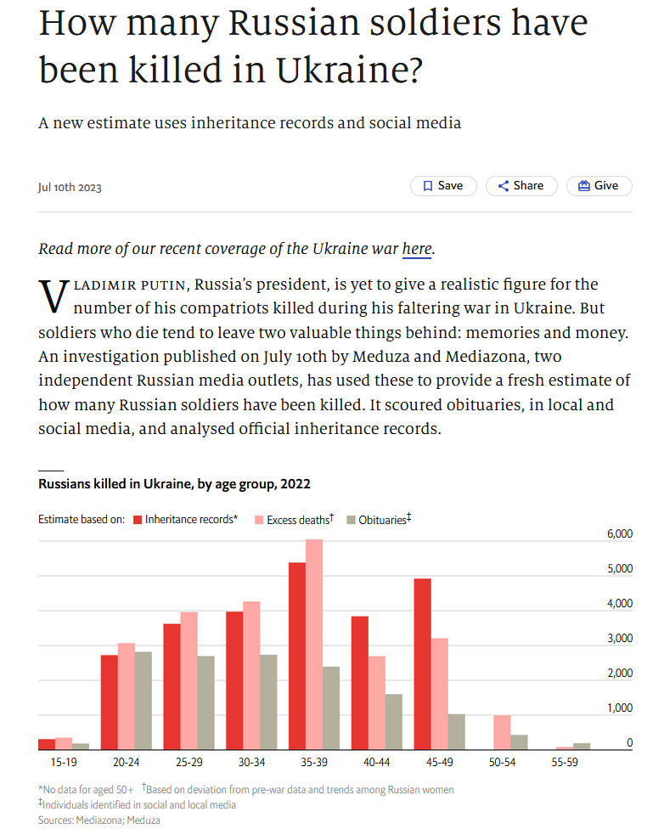
2. War in Ukraine
Source: The Economist
How do you interpret this data?
What questions do you have about the data?
What is interesting about the data?
Pick 1-2 data ponts and explain their significance.
What are the overall implications from this data?

Slide 4
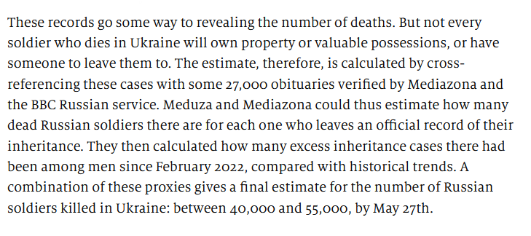
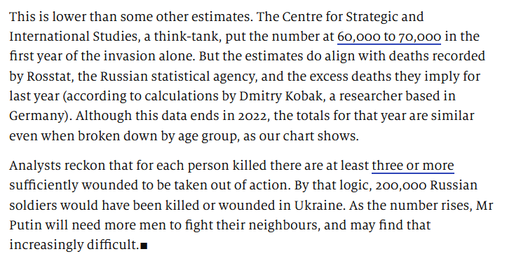
2. War in Ukraine
(Cont’d)

